Slide 1

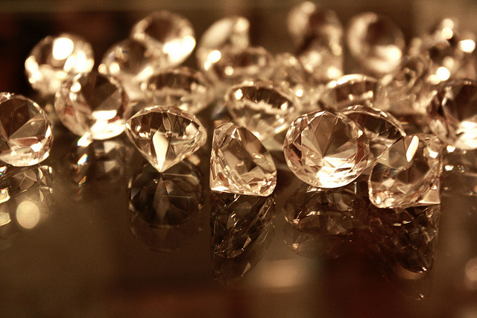

Price Behavioral Patterns of Diamonds
By
Sai Varun Teja Mudumba
(11252193)
This Photo by Unknown Author is licensed under CC BY-SA-NC

Slide 2

Diamond?
Diamonds are a component of carbon which has its atoms arranged in a crystal format and they are formed deep inside the bottom layers of the earth because of the intense pressure and temperatures.
The carbon atoms of the diamonds are packed so rigidly inside such that the color of the diamond varies drastically even with the presence of small percentages of impurities.
This Photo by Unknown Author is licensed under CC BY

Slide 3

Why Diamond is So costly?
Since they are formed only in the deeper layers of the earth and that too at higher temperatures and pressures, it makes the extraction process of a Diamond a difficult task.
And since the temperatures and the pressure requirements need to be met, there are not formed so common and are rarely found in only some parts of the world.
Because of all these reasons, they stand to be one of the costliest gems available in the world.
The cost of it is not limited just by the above facts but is also dependent on the 4C’s
In the 20th century the gemologists came up with a grading rubric which computes the characteristics of the diamonds commonly based on the four C’s namely the Carat, Clarity, Color, and Cut.

Slide 4
The 4 C’s
CARAT:
The carat of the diamond gives us the details about the mass of the diamonds and one carat equals 200 units in milligrams.
CLARITY:
Clarity defines the perfection of the diamond. It gives us the information about the structural details of the diamond such as cracks or the presence of other materials.
CUT:
Cut refers not to a diamond's shape (e.g. round, oval, pear, etc.) but to a diamond's proportions, symmetry, and polish diamond cut
COLOR:
Color explains about the saturation and the depth of the color of the diamond. The color of the diamonds varies from Colorless to the light yellow.

Slide 5
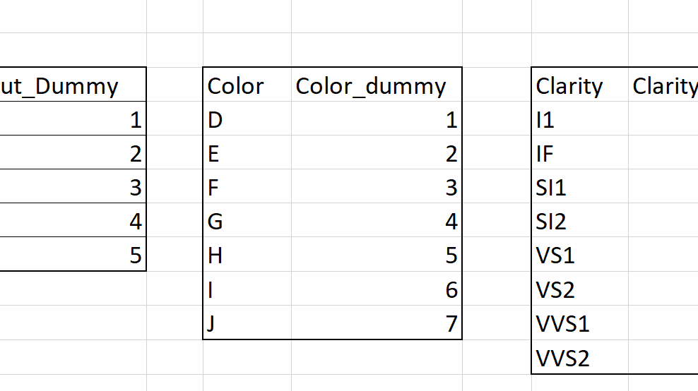
Exploratory Data analysis
Because of the presence of the categorical variables, firstly we need to convert them to numerical data by, dummy coding.
And by visualizing all the variables distributions and its relation with the Price it is evident that the Price is strongly dependent on Carat.
And all the other variables have nearly a linear relation with the price.

Slide 6
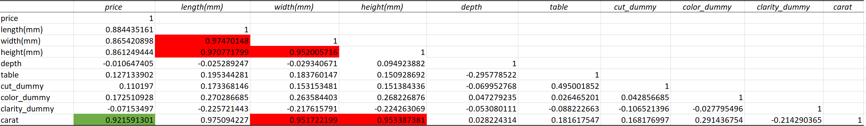
Research Questions
Strongly correlated attribute with Price?
The price is strongly correlated with the Carat attribute and its correlation coefficient is 0.92
The least Correlated Attribute with Price?
Price is least correlated with the Clarity and Depth and they have a negative relation with Price

Slide 7
Multiple Linear Regression
The Regression output with all the variables gives us a R2 of 0.885.
The Price Equation is given as:
Price=15321.8+10992.63(Carat)+287.13(Clarity_dum)-266(Color_dum)-47.9(Cut_dum)-72.5(table)-158.2(depth)-8.4(height)+38.3(width)-1173(length)

Slide 8
Insignificant Variables
Length
01
Width
02
Height
03

Slide 9
Regression with significant Variables
The regression model without length, width and height resulted in the R2 value of 88.5%, which tells us that only 0.5% of the variance in price is explained by them.
The equation is modified as
Price=7856.8+8361.2(Carat)+301.6(Clarity_dum)-256.9(Color_dum)-51.97(Cut_dum)-71.82(table)-111.3(depth)

Slide 10
This explains that as the carat increases by one unit, it alters the price by $8361 and in the similar fashion based on the Clarity grading adds a multiple of $301.6 based on the type of Clarity grading, Color subtracts a multiple of $256.9 based on the type of color and even the cut subtracts a multiple of $51.97 based on the type of cut. Table and depth have a negative impact on the price and it decreases the price by $71.82 and $111.3 respectively.

Slide 11

Deeper insights In the Project report
, by using this model of price prediction of diamonds, the customers can make use of this model and estimate the price of the diamonds that they wish to buy by putting in the carat weights, color, clarity, cut, the table and depth values.

Slide 12
This data presented does not take into consideration of the supply and demand factors. So, this data lacks the power to estimate the prices in such scenarios.
the taxes on goods like diamonds depends on the countries and this data lacks the taxes information based on the country as well which makes it incompatible to predict the accurate diamond prices.
So, assuming data covers all the other limitations then this can guide the buyers helps them to track the diamond prices and save them from greedy retailers.

Slide 13
Thank you!

